Slide 1
R. H. Smith School of Business Ranking Data System
Data Power Multiplication, Inc.
Farah Bushra, Shiv Lanka, Yash Shetty, and
Harry Leeser
December 5, 2023

Slide 2
Background
The Smith School of Business needs a data system to help track how the School and its programs are ranked by different entities across multiple years, with a focus on Graduate Programs.
Business Requirements
Store all annual rankings of the school and its programs from various sources
Programs can be categorized into program groups, such as undergraduate, graduate, MBAs, and other masters programs
Rankings apply to either the whole school, a program group, or a specific program
Sources need to be stored with what type of source they are, such as a news organization or an educational analytics organization, as well as a URL for their website
Rankings need to include the actual ranking, the year of the ranking, and what type of ranking they are (i.e. international, U.S., the Mid-Atlantic region, etc.)
The system needs to be able to show rankings by source, by program/group, and by ranking year
If a source is in the system, it should have at least one associated ranking in the system
Programs do not need to have an associated ranking or source.

Slide 3
Our Mission
To provide the University of Maryland Robert H. Smith School of Business with a database system that enables the school to track and analyze the school’s annual ranking, as well as the annual rankings of individual programs within the school, from multiple sources.
Mission Objectives
To find the top 3 annual rankings for the school, or one of its programs for a given year to help pick which rankings to advertise
Smith School
Smith School Undergraduate
Smith School Graduate
Smith School Masters Programs
Smith School MBA Programs
Etc.
To find the bottom 3 annual rankings for the school, or one of its programs for a given year to direct research into how the school can improve its average rankings
See above
To find all annual rankings from one specific source for Smith or one of its programs (i.e. US News and World Report, Masters in Information Systems)
To show average rankings each year for a given program across all sources
Find which sources rank which programs
Notes:
Maybe Improve/Tailor mission statement

Slide 4
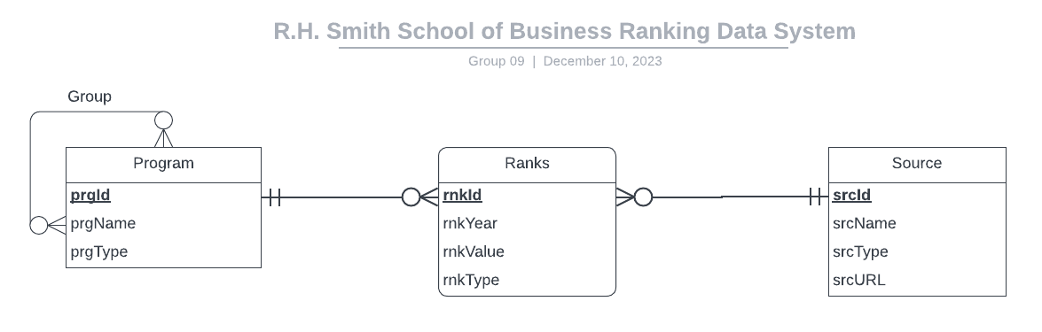
System Overview

Slide 5
Relational Schema
Program(prgId, prgName, prgType)
Source(srcId, srcName, srcType, srcURL)
Ranks(rnkId, rnkYear, rnkValue, rnkType, srcId, prgId)
ProgramGroups(prgId, subPrgId)

Slide 6
Table Creation Code

Slide 7
Program Table SQL
CREATE TABLE [Program] (
prgId CHAR (4) NOT NULL,
prgName VARCHAR (30),
prgType VARCHAR (15),
CONSTRAINT pk_Program_prgId PRIMARY KEY (prgId),
);

Slide 8
Source Table SQL
CREATE TABLE [Source] (
srcId CHAR (4) NOT NULL,
srcName VARCHAR (40),
srcType VARCHAR (15),
srcURL VARCHAR (255),
CONSTRAINT pk_Source_srcId PRIMARY KEY (srcId),
);

Slide 9
Rank Table SQL
CREATE TABLE [Ranks] (
rnkId CHAR (5) NOT NULL,
srcId CHAR (4) NOT NULL,
prgId CHAR (4) NOT NULL,
rnkYear CHAR (4),
rnkValue INT,
rnkType CHAR (20),
CONSTRAINT pk_Ranks_rnkId PRIMARY KEY (rnkId),
CONSTRAINT fk_Ranks_srcId FOREIGN KEY (srcId)
REFERENCES [Source] (srcId)
ON DELETE NO ACTION ON UPDATE CASCADE,
CONSTRAINT fk_Ranks_prgId FOREIGN KEY (prgId)
REFERENCES [Program] (prgId)
ON DELETE NO ACTION ON UPDATE CASCADE
);

Slide 10
ProgramGroups Table SQL
CREATE TABLE [ProgramGroups] (
prgId CHAR (4) NOT NULL,
subPrgId CHAR (4) NOT NULL,
CONSTRAINT pk_ProgramGroups_prgId_subPrgId PRIMARY KEY (rnkId),
CONSTRAINT fk_ProgramGroups_prgId FOREIGN KEY
(prgId)
REFERENCES [Program] (prgId)
ON DELETE NO ACTION ON UPDATE NO ACTION,
CONSTRAINT fk_ProgramGroups_subPrgId FOREIGN
KEY (subPrgId)
REFERENCES [Program] (subPrgId)
ON DELETE NO ACTION ON UPDATE NO ACTION
);

Slide 11
Business Transactions

Slide 12
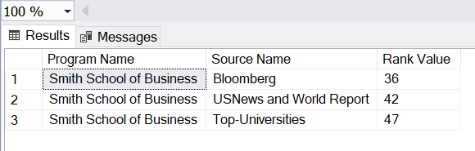
What are the top 3 rankings for the school in 2022?
SELECT TOP 3 p.prgName AS ‘Program Name’,
s.srcName
AS ‘Source Name’, r.rnkValue AS ‘Rank Value’
FROM dbo.Ranks r
JOIN dbo.Source s ON r.srcId = s.srcId
JOIN dbo.Program p ON r.prgId = p.prgId
WHERE r.rnkYear = '2022' AND p.prgId = 'P001'
ORDER BY r.rnkValue ASC

Slide 13
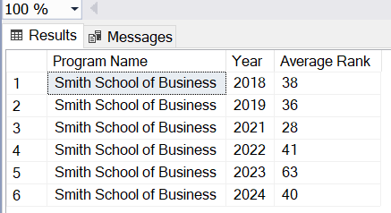
What is the average rank for the Smith School for each year with rankings in the database?
SELECT p.prgName AS 'Program Name', r.rnkYear AS 'Year',
AVG(r.rnkValue) AS 'Average Rank'
FROM dbo.Ranks r
JOIN dbo.Program p ON r.prgId = p.prgId
WHERE p.prgId = 'P001'
GROUP BY r.rnkYear

Slide 14
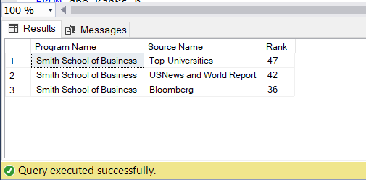
What are the bottom 3 rankings for the school in 2022?
By Program ID–
SELECT TOP 3 p.prgName AS ‘Program Name’, s.srcName AS 'Source Name', r.rnkValue AS 'Rank' FROM dbo.Ranks r JOIN dbo.Source s ON r.srcId = s.srcId JOIN dbo.Program p ON r.prgId = p.prgId WHERE r.rnkYear = '2022' AND p.prgId = 'P001' ORDER BY r.rnkValue DESC ;
By Program Name–
SELECT TOP 3 p.prgName AS ‘Program Name’, s.srcName AS 'Source Name', r.rnkValue AS 'Rank' FROM dbo.Ranks r JOIN dbo.Source s ON r.srcId = s.srcId JOIN dbo.Program p ON r.prgId = p.prgId WHERE r.rnkYear = '2022' AND p.prgName = 'Smith School of Business' ORDER BY r.rnkValue DESC ;

Slide 15
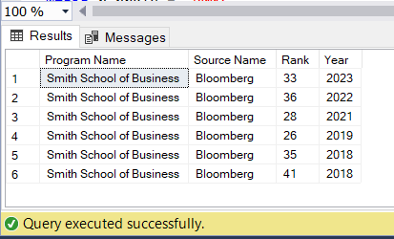
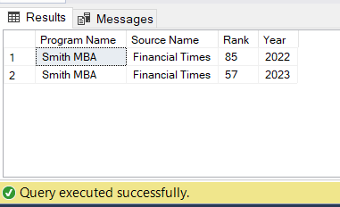
What are all the annual rankings from one specific source?
Smith School ranks from Bloomberg by program and source IDs–
SELECT TOP 3 p.prgName AS ‘Program Name’, s.srcName AS 'Source Name', r.rnkValue AS 'Rank' r.rnkYear AS 'Year' FROM dbo.Ranks r JOIN dbo.Source s ON r.srcId = s.srcId JOIN dbo.Program p ON r.prgId = p.prgId WHERE p.prgId = 'P001' AND s.srcId='S004' ;
Smith MBA ranks from Financial Times by program and source IDs–
SELECT TOP 3 p.prgName AS ‘Program Name’, s.srcName AS 'Source Name', r.rnkValue AS 'Rank' r.rnkYear AS 'Year' FROM dbo.Ranks r JOIN dbo.Source s ON r.srcId = s.srcId JOIN dbo.Program p ON r.prgId = p.prgId WHERE p.prgName = 'Smith MBA' AND s.srcName='Financial Times' ;

Slide 16
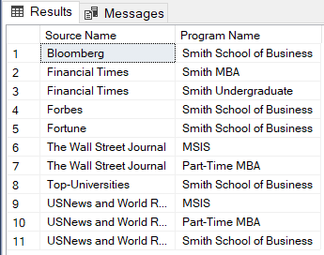
Which sources rank which programs?
SELECT DISTINCT s.srcName AS 'Source Name', p.prgName AS ‘Program Name’, FROM dbo.Ranks r JOIN dbo.Source s ON r.srcId = s.srcId JOIN dbo.Program p ON r.prgId = p.prgId ;

Slide 17
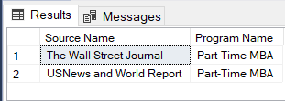
Which sources rank a specific Program?
By Program ID–
SELECT DISTINCT s.srcName AS 'Source Name', p.prgName AS ‘Program Name’, FROM dbo.Ranks r JOIN dbo.Source s ON r.srcId = s.srcId JOIN dbo.Program p ON r.prgId = p.prgId WHERE p.prgId = 'P005' ;
By Program Name–
SELECT DISTINCT s.srcName AS 'Source Name', p.prgName AS ‘Program Name’, FROM dbo.Ranks r JOIN dbo.Source s ON r.srcId = s.srcId JOIN dbo.Program p ON r.prgId = p.prgId WHERE p.prgName = 'Part-Time MBA' ;

Slide 18
Thank you

